Slide 1
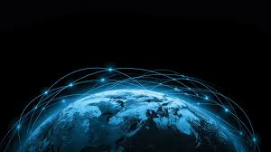
IMAGE PROCESSING IN REMOTE SENSING
Group No 14
Shyam Kawale [29]
Bhargav Pawar [50]
Nishant Bhat [43]
Abhijit Gawai [18]
Guided by Prof. Deepali Despande mam
esri.com

Slide 2
Contents
What is Remote sensing
Process of Remote Sensing
Phases of Remote Sensing
Types of Remote Sensing
Image Registration
Image Fusion
Image Segmentation
Image Classification
Decision tree building
Resultant Classification
Conclusion

Slide 3
WHAT IS REMOTE SENSING?
Remote sensing is the science of making inferences about the objects from measurements at a distance, without coming into physical contact with the object being measured.
It’s the science of-
Acquiring images through various means.
Processing refers to processes that covert raw data into images.
Interpreting involves converting an image for human use.

Slide 4
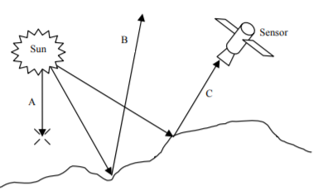
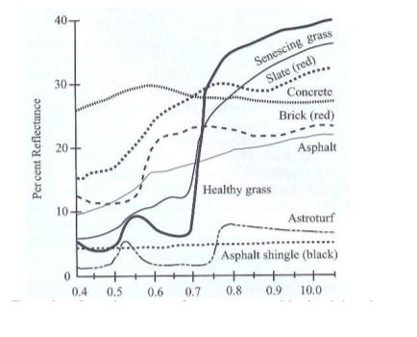
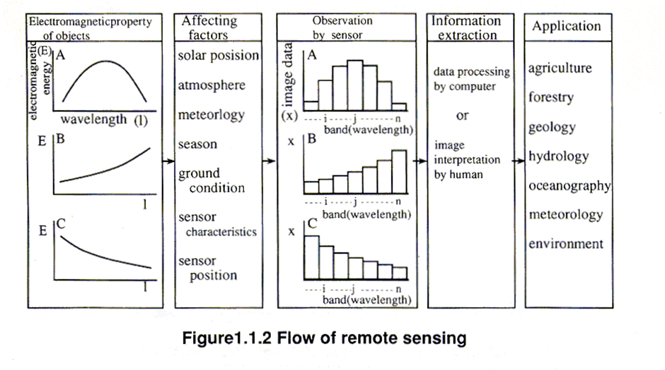
PROCESS OF REMOTE SENSING
https://publons.com/journal/115153/tutorials-of-the-xxii-brazilian-symposium-on-compu/

Slide 5
PHASES OF REMOTE SENSING
DATA ACQUISITION:
Energy source
Propagation of energy through the earth atmosphere
Energy interaction with earth surface.
Generation of sensor data in forms of picture or digital information.
DATA ANALYSIS:
Examining data using various viewing instruments to analyse pictorial data.
Reference data and ground truth check is an essential part.
Finally the information is presented to the users.

Slide 6
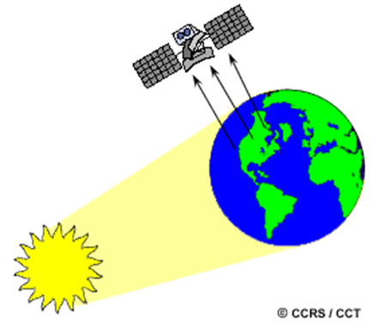
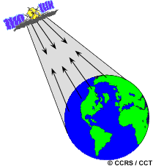
TYPES OF REMOTE SENSING
Passive remote sensing:
Active remote sensing:
nrcan.gc.ga

Slide 7
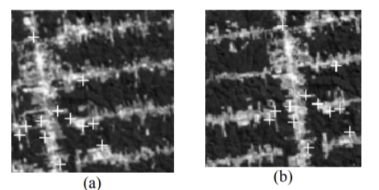
IMAGE REGISTRATION
Registration is a process which makes the pixels in two images precisely coincide to same points in the scene.
Crucial step in all image analysis
The general approach to image registration consists of the four following steps:-
Feature identification
Feature matching
Spatial transformation
Interpolation
Reference:-Digital Image Processing in Remote Sensing
Leila M. G. Fonseca, Laércio M. Namikawa and Emiliano F. Castejon

Slide 8
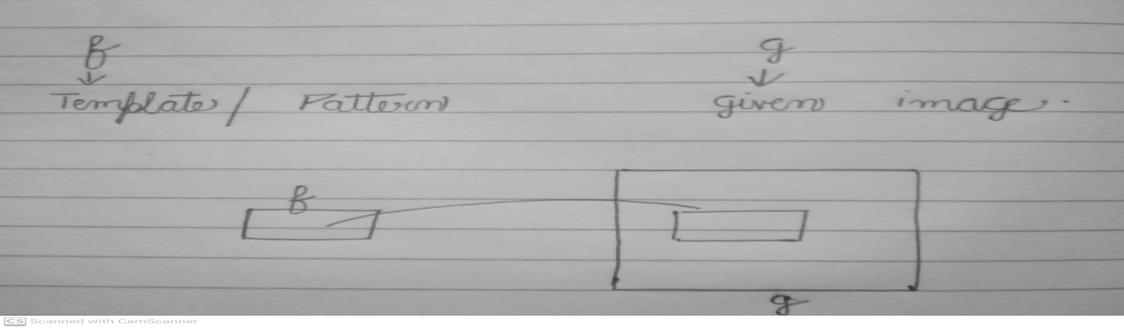
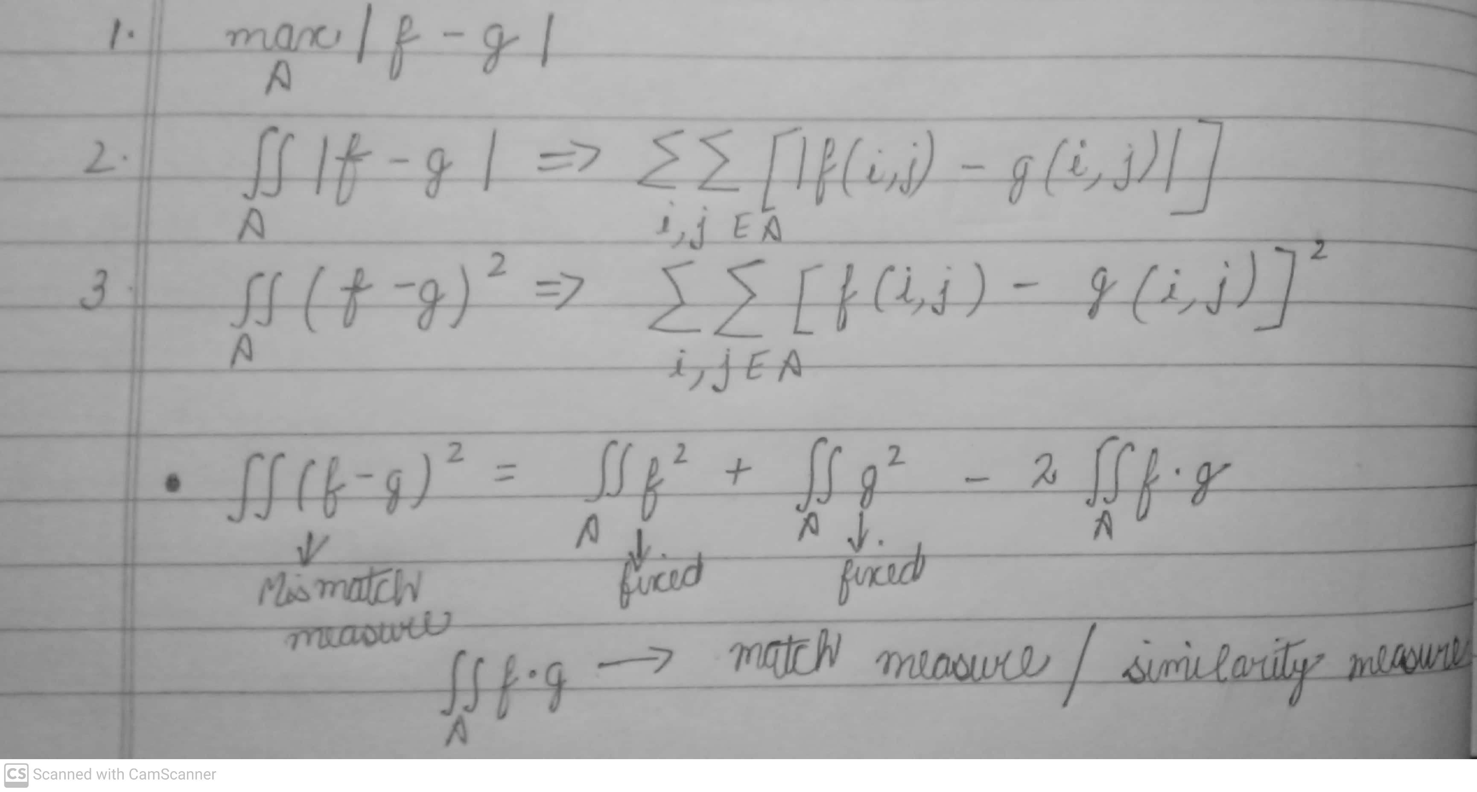
IMAGE REGISTRATION TECHNIQUES
Mismatch measure and match measure/Similarity measure
Ways of measuring mismatch :-

Slide 9
IMAGE FUSION
Combining two or more registered images of some object into a single image that is more easily interpreted than any of the original.
The goal of image fusion is to create new images that are more suitable for the purpose of human visual perception
Remote sensing image fusion
Images fusion in remote sensing has several application domains.
In satellite imagery we can have two types of images:-
Panchromatic images
Multispectral inages

Slide 10
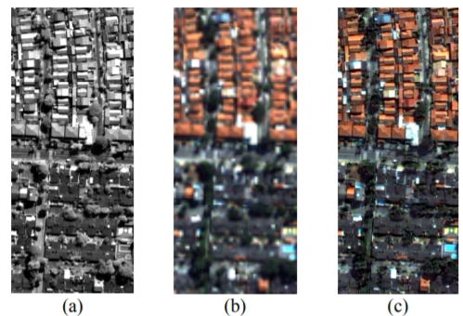
IMAGE FUSION TECHNIQUES
The standard merging methods of image fusion are based on red green blue(RGB) to intensity hue saturation (HIS) transformation. The usual steps involved in satellite image fusion are as follows:-
Registering the low resolution multispectral images
Transform the RGB bands of the multispectral image into IHS components
Modifying the panchromatic image with respect to the multispectral image.
Replacing the intensity components
Reference:-Digital Image Processing in Remote Sensing
Leila M. G. Fonseca, Laércio M. Namikawa and Emiliano F. Castejon

Slide 11
Image Segmentation
Segmentation procedures partitions an image into its constitute parts or objects.
Level of Segmentation = Application dependent
Hard to implement.
Really important step for every remote sensing application.
Image Segmentation
Discontinuity Based
Similarity Based
Isolated Points
Lines
Edges
1.Thresholding
2. Region Growing
3. Region Splitting and merging

Slide 12
Edge Detection
Image processing technique for finding the boundaries of objects within images.
Most commonly used approach.
Edge : Boundary between two regions having distinct intensity levels or having distinct gray levels.
A
B

Slide 13
Edge Detection - Analysis
A
B
Intensity graph
1st order derivative
2nd order derivative

Slide 14
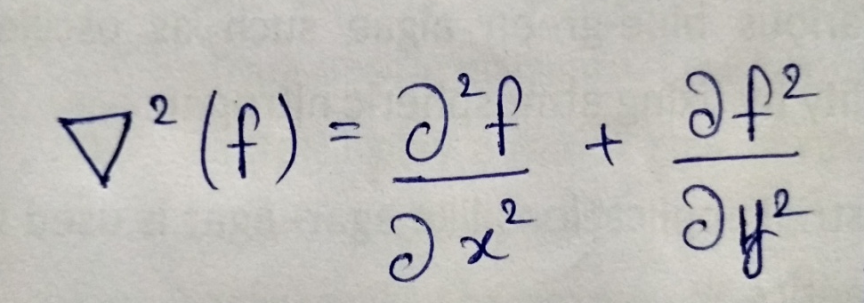
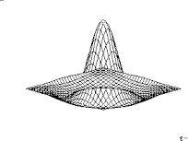
Using 2nd Derivative
Laplacian Operator:
0 | -1 | 0
-1 | 4 | -1
0 | -1 | 0
Laplacian Mask
Disadvantage of 2nd derivative method:
It is very sensitive to noise.
Leads to double edges at every transition.
*** To remove this diadvantages we take help from Gausian operator. ***

Slide 15
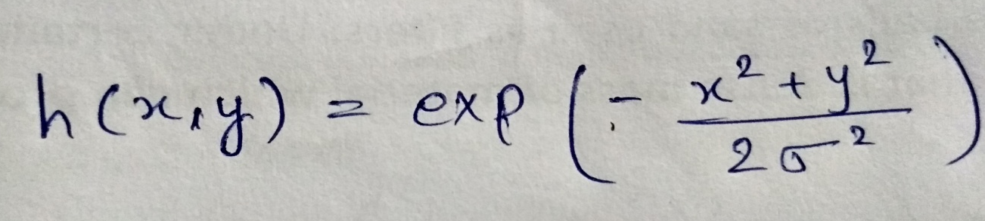
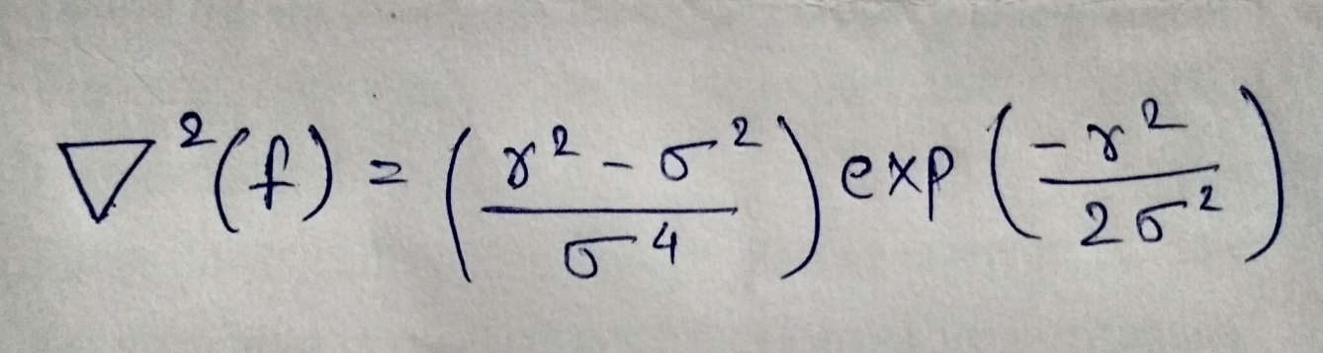
Using 2nd Derivative
Gaussian Operator:
Laplacian + Gaussian Operator = Laplacian of Gaussian Operator (LOG).
σ = standard deviation
Where
r^2 = x^2 + y^2

Slide 16
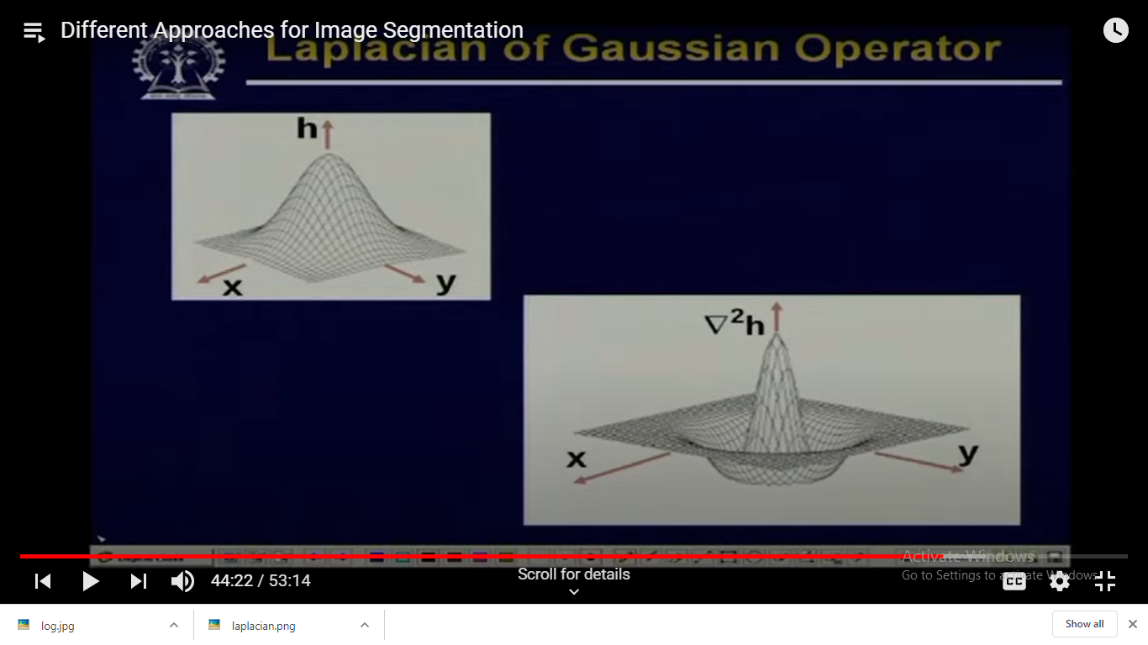
Graphical Representation
0 | 0 | -1 | 0 | 0
0 | -1 | -2 | -1 | 0
-1 | -2 | 16 | -2 | -1
0 | -1 | -2 | -1 | 0
0 | 0 | -1 | 0 | 0
Mask of LOG operator
Fig: Graphical Representation of LOG operator
ref:
http://dspace.calstate.edu/bitstream/handle/10211.3/203687/Mirzataraj-Soudabeh-thesis-2018.pdf?sequence=1

Slide 17
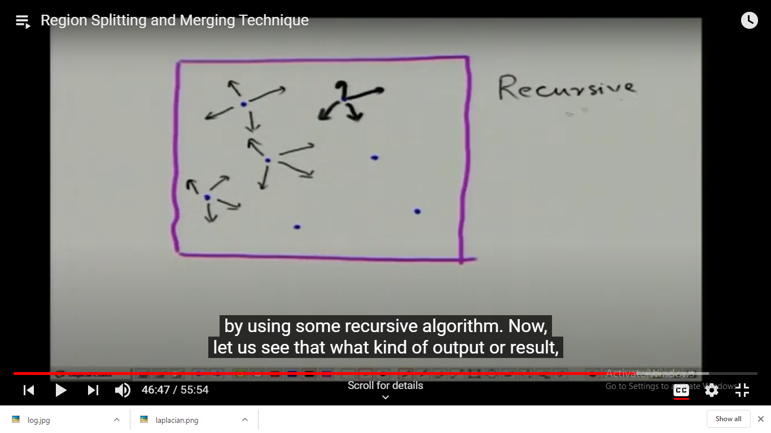
Region Growing
Groups the pixels or sub regions into a larger region based on some predefined condition.
R = R1 + R2 + R3 +….. + Rn
where 1) U( Ri ) = R (from i=1 to i=n).
2) Ri should be connected region.
3) Ri union Rj = null
Seed Points
Fig: growing of region

Slide 18
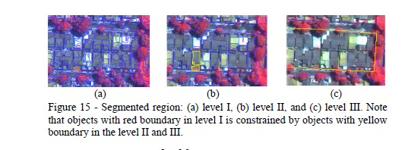
Examples
Ref: Korting, T. S, Dutra, L.V., Fonseca, L.M.G. Detecting Rectangular
Objects in Urban Imagery - A Re-Segmentation Approach. VISAPP.
Lisbon, Portugal. 2009.

Slide 19
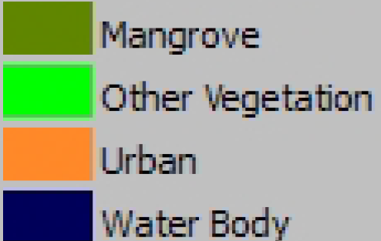
Image Classification
Image
Classification
Image Segmentation Output
Classified Image
Classes

Slide 20
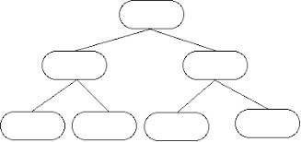
Image Classification
How Image Classification works?
Decision Tree
Segmented Image

Slide 21
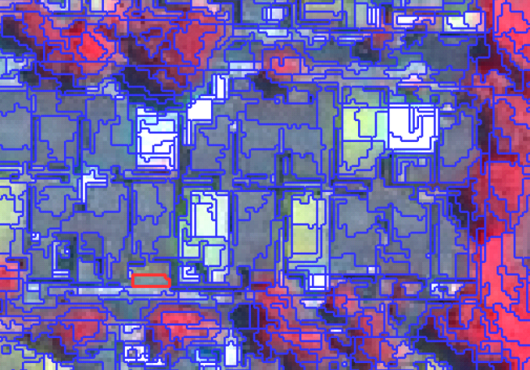
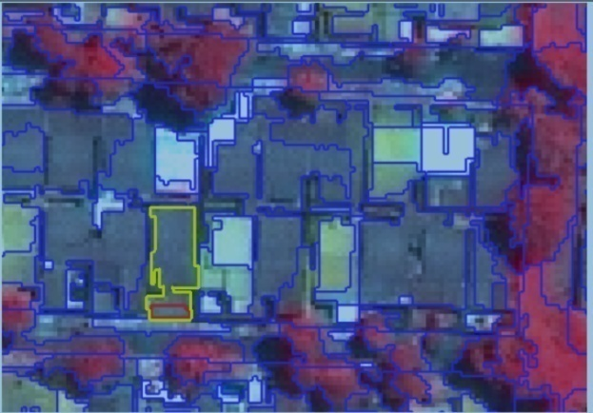
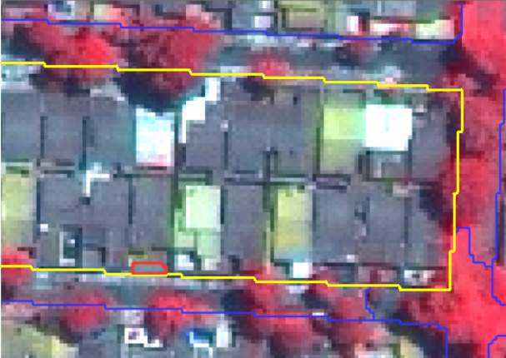
Level 1 Classification
Level 2 Classification
Level 3 Classification
21

Slide 22

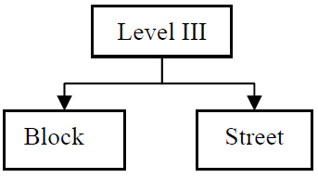
Decision Tree Building
Level 3 Classification
Defines objects as blocks and
streets

Slide 23

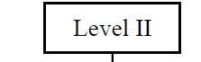
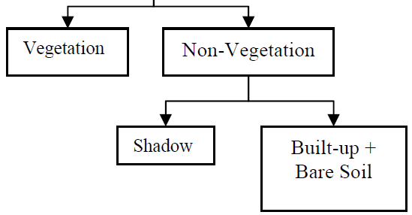
Decision Tree Building
Level 2 Classification
Differentiates vegetation and
Non-vegetation areas

Slide 24
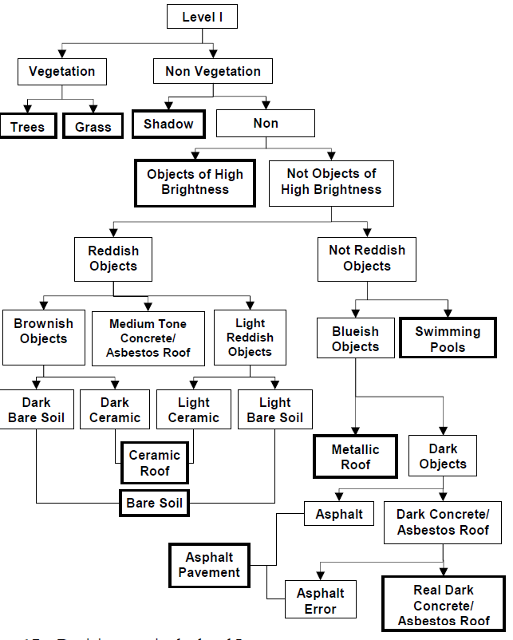
Decision Tree Building
Level 1 Classification
Separates objects based on land
cover classes;

Slide 25
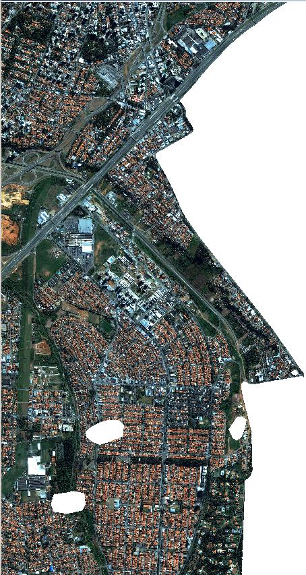
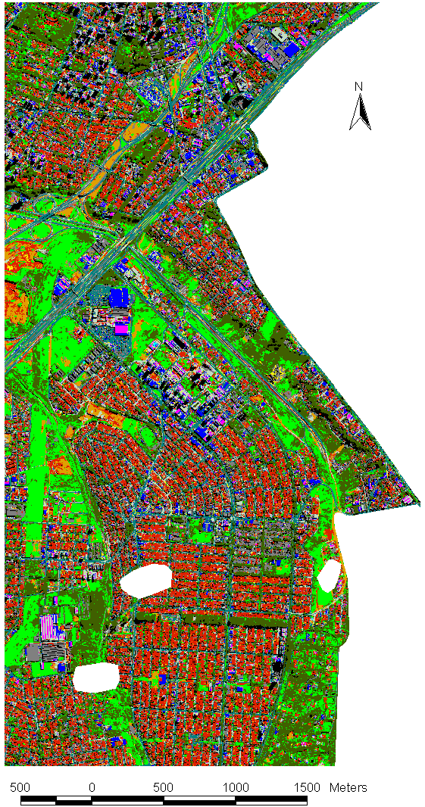
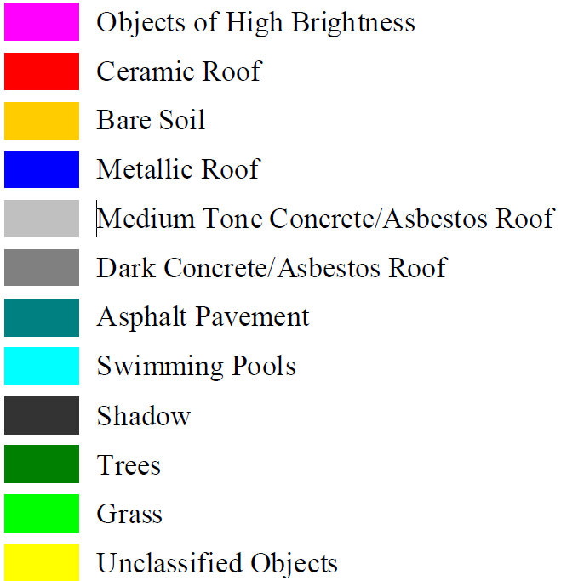
Resultant classification
Categories
Original color image
Thematic map

Slide 26
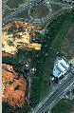
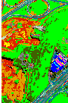
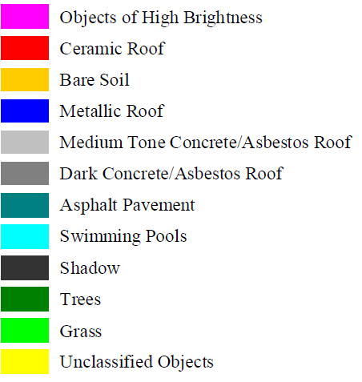
Resultant classification
Categories
Original color image
Thematic map

Slide 27
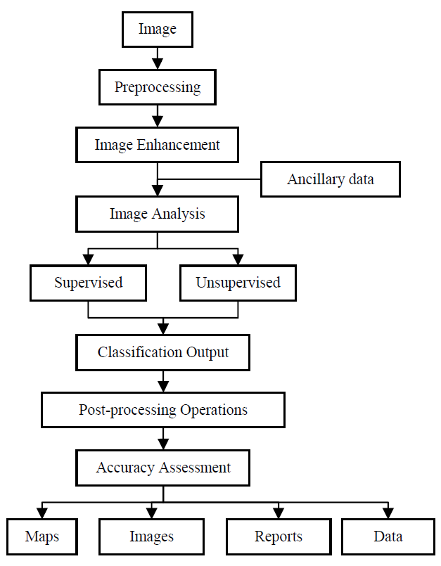
CONCLUSION
For each remote sensing application a specific processing methodology must be developed.
Remote sensing application requires information about the data characteristics, region of interest, and the type of result interested.
Fundamental steps in remote sensing image processing

Slide 28
References
[1] Digital Image Processing in Remote Sensing
Leila M. G. Fonseca, Laércio M. Namikawa and Emiliano F. Castejon, Av dos Astronautas, 1.758
[2] https://publons.com/journal/115153/tutorials-of-the-xxii-brazilian-symposium-on-compu/
[3] Korting, T. S, Dutra, L.V., Fonseca, L.M.G. Detecting Rectangular
Objects in Urban Imagery - A Re-Segmentation Approach. VISAPP.
Lisbon, Portugal. 2009.
[4] Haralick, R. & Shapiro, L., 1985: Image segmentation techniques.
Computer Vision, Graphics, and Image Processing, vol. 29, pp 100-132.
[5] https://nptel.ac.in/courses/106/105/106105032/
[6] Schowengerdt, R. A Remote Sensing Models and Methods for Image
Processing, London, Academic Press, 1997, p.521.

Slide 29
Thank YOu

